Slide 1
ISG Sprint Demo Event: OGC and Khronos Group |
Dr. Scott Serich, Director, OGC>
September 25, 2020

Slide 2
Demo Agenda
… can be found in the GitHub repository at https://github.com/opengeospatial/OGC-ISG-Sprint-Sep-2020/wiki/ISG-Sprint-Demo-Event-Agenda .

Slide 3
Welcoming Remarks
Welcome.
Purpose of today’s event.
Team Members
Sponsor reps.
USSOCOM, AGC.
Participants.
CAE, Cesium, Cognitics, Ecere, Helyx, Hexagon, InfoDao, SimBlocks, Steinbeis.
OGC and Khronos Group.
Invited Guests.

Slide 4
Invited Guests
Invited Guests.
Sponsor Team.
OGC and Khronos Group.
Participants.

Slide 5
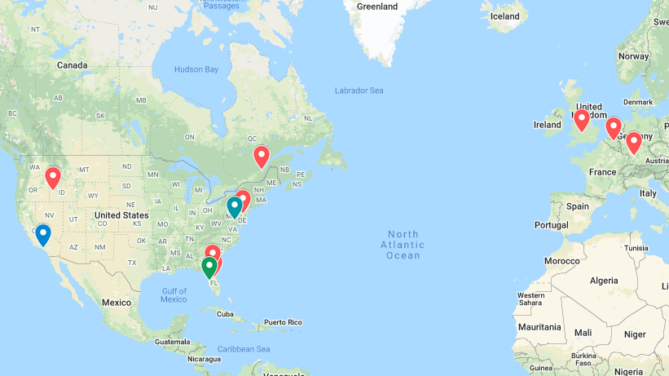
Where in the World

Slide 6
Participant Presentations
CAE, Cesium, Cognitics.
Pause for Q&A.
Helyx, Ecere, InfoDao.
Pause for Q&A.
Hexagon, Steinbeis, SimBlocks.
Additional Q&A.

Slide 7
Q&A
Any additional questions or comments?
.

Slide 8
Wrap-Up and Next Steps
Upload (reworked) videos to OGC YouTube Channel
https://www.youtube.com/user/ogcvideo/playlists .
Additional TIE Testing next week.
Participant Sprint Report inputs due October 5.
AOB?

Slide 9
Thank you.
Thank you.

Slide 10
Document Resources
OGC Specifications, Document, and Reports
GeoVolume (https://portal.ogc.org/files/?artifact_id=94029)
Pilot Engineering Report
Exec Summary: https://portal.ogc.org/files/?artifact_id=94030
Experiences: https://portal.ogc.org/files/?artifact_id=94028
Other documents – all listed in CfP (https://portal.ogc.org/files/?artifact_id=94059)

Slide 11
Other Documents
Khronos Group – glTF
V2.0 2017-06-09: https://github.com/KhronosGroup/glTF/tree/master/specification/2.0
Continually updated with extensions
Beginning to start ISO ratification process for Publicly Available Specification

